Slide 1
College chatbot
CAPSTONE PROJECT
Presented By:
1. Abhisek Samantaray-Gita Autonomous College-Computer Science and Engineering

Slide 2
OUTLINE
Problem Statement
Proposed System/Solution
System Development Approach
Algorithm & Deployment
Result
Conclusion
Future Scope
References
IBM Watson chatbot link
Copy and paste the link on goggle this link is working

Slide 3
Problem Statement
All customers of the company want when they call a company for help to have their problem solved in one session as quickly as possible because they do not want top services, they want resolution. That’s why first contact resolution (FCR) is one of the most important metrics in customer care.
IBM Watson chatbot released feature to enable our AI and answer customer questions , to graceful transfer more complex questions to a human and to help the human agents find answer quickly and correctly
It also uses in several organisation to answer their customers question in correctly and efficient manner.
IBM watson chatbot link

Slide 4
Proposed Solution
The proposed system in IBM Watson Chatbot helps to solve problem in customers in quick and accurate manner which would not be provided before in a customer call .This involves data analytics and machine learning techniques to forecast demand pattern correctly. The solution will consist of following patterns
Data Sources:
Data storage in object storage is Watson query , stored files ,query of customers and answer
Also uses sources are IBM cloud , Amazon S3, Generic S3 data source
Data Preprocessing:
Its environment is mainly responsible for contextualizing users message using natural language processing.
Then NLP interprets what users are saying at any given times an turn it into organised input
Machine Learning Algorithm:
Watson leverages Machine learning algorithm analyses vast amounts of data including conversational logs and user feedback
Consider incorporating other factors like weather conditions, day of the week, and special events to improve prediction accuracy.
Deployment:
Develop a user-friendly interface or application that provides real-time predictions for bike counts at different hours.
Deploy the solution on a scalable and reliable platform, considering factors like server infrastructure, response time, and user accessibility.
Evaluation:
It is a tool utilizing conversational AI.it is built on deep learning , natural language processing and machine learning
Fine-tune the model based on feedback and continuous monitoring of prediction accuracy.
Result:

Slide 5
System Approach
The "System Approach" section outlines the overall strategy and methodology for developing and implementing the IBM Watson chatbot and these are divided into 2 parts
System requirements :- desktop , internet , IBM Cloud Account
Library required to build the model :- IBM library cloud , Watson assistant in library ,
IBM Watson chatbot link (copy and paste the link on goggle)

Slide 6
Algorithm & Deployment
In the Algorithm section, describe the machine learning algorithm to use IBM Watson chatbot .Here is an example structure for this session
Algorithm Selection:
It uses the NLP to understand and process the human language enable them to engage a meaningful concertation with users. It breaks down the text into various parts such as word phrases and analyse the context which we used
Data Input:
Gives the chatbot to the customers query and answer in correctly manner which would be applicable for all the customer
Training Process:
After provide the query and answer in correctly manner check it in the preview section .
Prediction Process:
It should be predicted in your general knowledge example if you make an admission chatbot of college provides the necessary question and answer which would be user want .
IBM Watson chatbot link
Copy and paste the link on goggle this is working

Slide 7
Result
In this college chatbot we input some questions i,.e gretting the customer and also write about courses and courses fees and also ask about the customer and after we write some basic answer in phrases section.
IBM Watson chatbot link
Paste the link on goggle

Slide 8
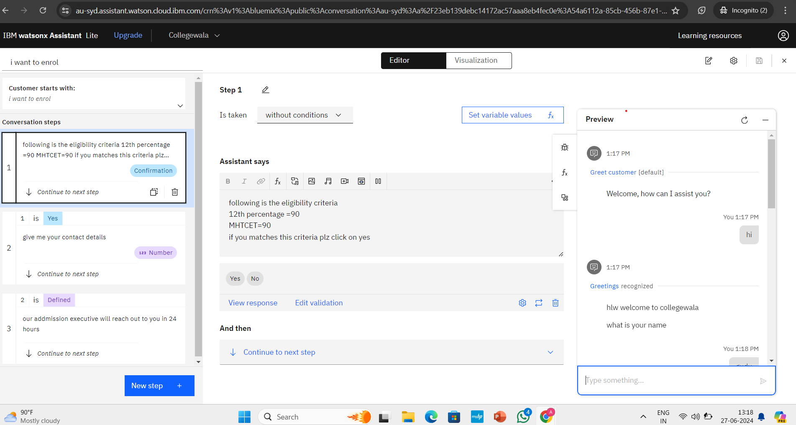
result

Slide 9
Conclusion
In conclusion, an IBM Watson chatbot is a valuable asset for enhancing customer service, boosting user engagement, and streamlining business operations. Utilizing natural language processing, machine learning, and AI insights, Watson chatbots can understand and respond to user inquiries effectively, providing personalized and efficient solutions. This technology not only improves operational efficiency but also increases user satisfaction through quick and accurate responses.
IBM Watson chatbot link
Copy and paste the link on goggle this link is working

Slide 10
Future scope
IBM Watson chatbot's future includes better natural language understanding, advanced AI integration, and broader use across industries. It will provide personalized, context-aware interactions, improve customer service, and aid complex decision-making, boosting efficiency and innovation in businesses globally.
IBM Watson chatbot link (Copy and paste the link on goggle this link is working)

Slide 11
References
This project would be uploaded in GitHub and LinkedIn to show the real world experience in tech and it would help in a good major project on my btech academics
Thanks eduent foundation to gave me this opportunity
IBM Watson chatbot link (Copy and paste the link on goggle this link is working)

Slide 12
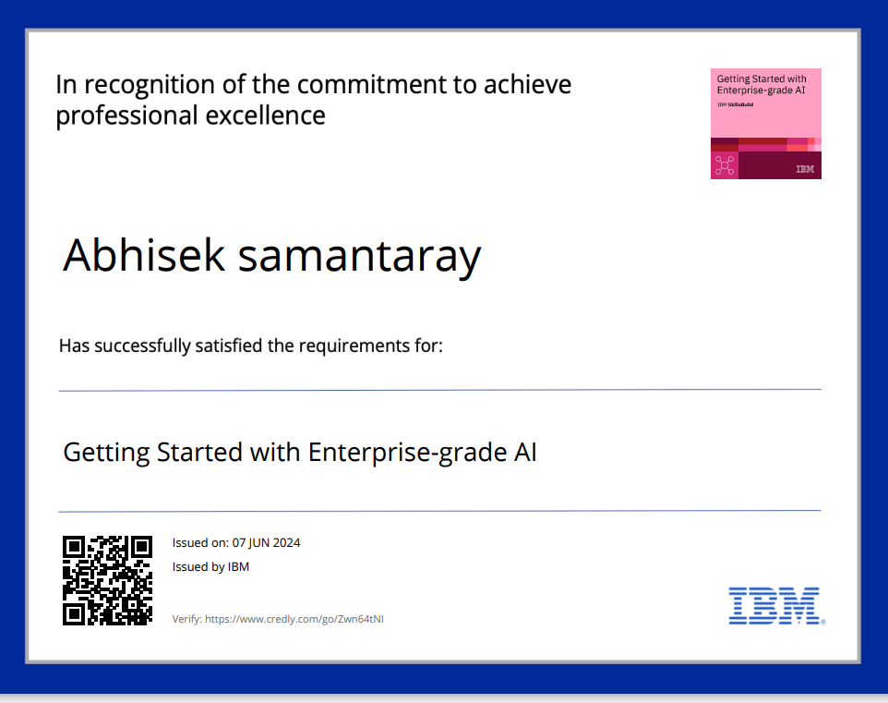
course certificate 1

Slide 13
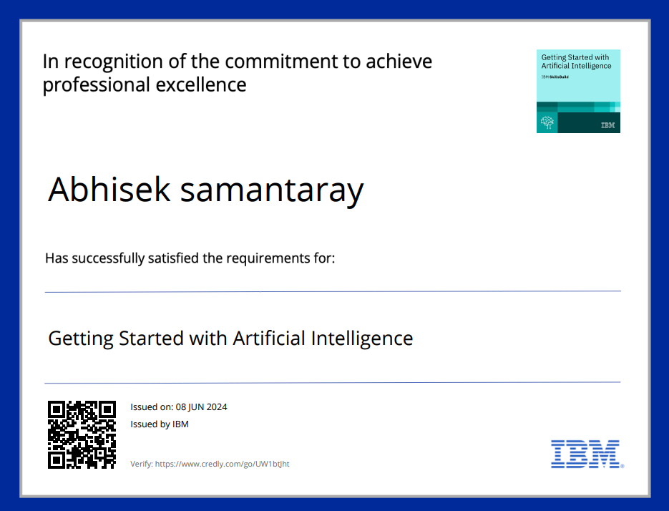
course certificate 2

Slide 14
THANK YOU

